Slide 1
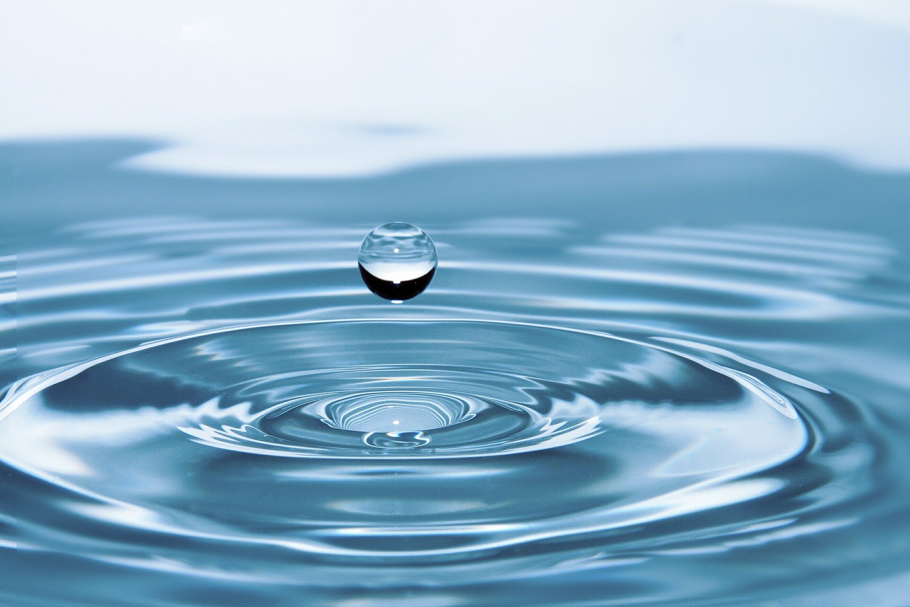
WATER CYCLE
We will explore the parts of the water cycle
Notes:
Insert cover image and use transparency settings to fade image.

Slide 2
Do not delete this slide.
This slide is designed so that you can copy the prompt box you need and insert it into your slides.
This slide is hidden and will not be included when presenting your lesson.
TRACK WITH ME
VOCABULARY
1 -
HINT
Students, remember….
CHECK FOR UNDERSTANDING
READ WITH ME
TEACHER CUE
MAKE THE CONNECTION
Students, you already know….
EXTENSION

Slide 3
Identify the independent and dependent variables from the following research questions:
Do tomatoes grow fastest under fluorescent, incandescent, or natural light?
What is the effect of diet and regular soda on blood sugar levels?
How does phone use before bedtime affect sleep?
How well do different plant species tolerate salt water?
HINT
Independent- change Dependent- measure

Slide 4
Repeat the opposite word/phrase.
SUMMARISE
WRITE THE MAIN IDEAS

Slide 5
Repeat the opposite word/phrase.
DEMONSTRATE
SHOW WITH ACTION

Slide 6
Repeat the opposite word/phrase.
INFERENCE
WHAT WE THINK IS HAPPENING

Slide 7
Repeat the opposite word/phrase.
SCIENTIFIC
TO DO WITH SCIENCE

Slide 8
We will explore₁ the parts of the water cycle
TRACK WITH ME
READ WITH ME
We will identify the parts of the water cycle
We will describe the interactions between the parts of the cycle
We will explore the impact of humans on the water cycle
DECLARE THE OBJECTIVE
Read the learning objective to your partner.
VOCABULARY
1 - inquire into or discuss (a subject) in detail.
Notes:
Learning Objectives contain concepts (nouns, big ideas), skills (verbs, measurable behaviours) and sometimes context (restricting or targeting conditions).
●Example: Students will be able to describe the concept of density and apply it to floating and sinking.
●
Success criteria are specific measurable outcomes that if met mean that the student has met the learning objective.
Examples:
•Students will be able to compare densities of substances using mass and volume.
•Students will be able to identify whether a solid or liquid will float or sink in a liquid based on their densities.

Slide 9
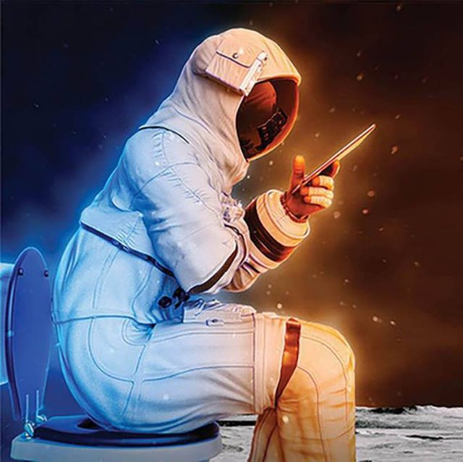
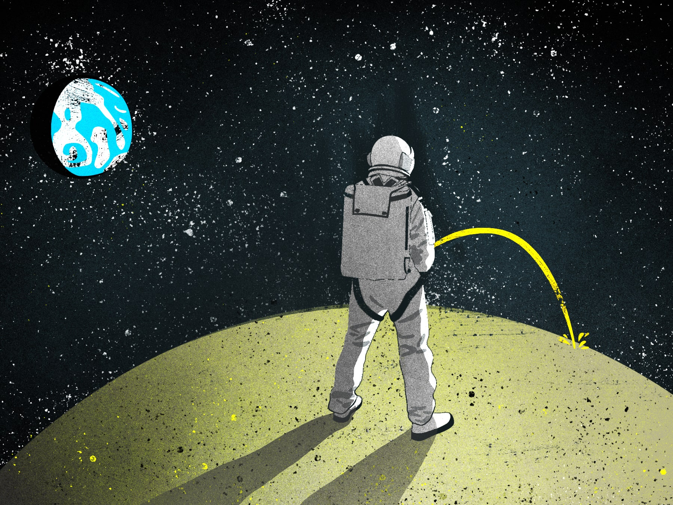
We will explore the parts of the water cycle
How thirsty would you need to be to drink your own pee?
End
1
2
3
4
5
6
7
8
9
10
11
12
13
14
15
16
17
18
19
20
21
22
23
24
25
26
27
28
29
30
CHECK FOR UNDERSTANDING
How is pee useful? How would you make it safe to drink?
Notes:
astronauts on the International Space Station do it all the time! This is not as gross as it sounds. Human urine is a mixture, but over 90% is water. The rest is a collection of chemicals and minerals that our bodies don't need. On the space station, the urine is passed through a complicated machine to separate out the wastes. So what the astronauts drink is highly purified water.

Slide 10
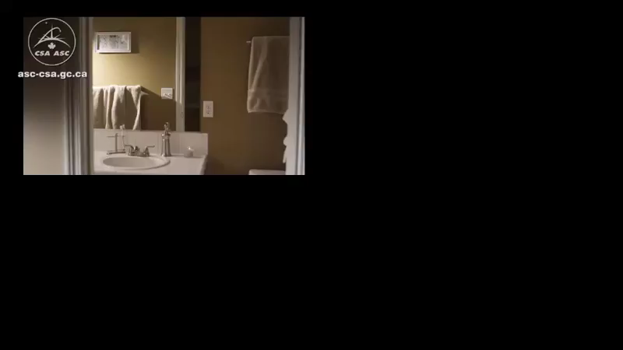
We will explore the parts of the water cycle
Explain how water is cycled on Mars.
Compare this cycle to the cycle on Earth
Notes:
astronauts on the International Space Station do it all the time! This is not as gross as it sounds. Human urine is a mixture, but over 90% is water. The rest is a collection of chemicals and minerals that our bodies don't need. On the space station, the urine is passed through a complicated machine to separate out the wastes. So what the astronauts drink is highly purified water.

Slide 11
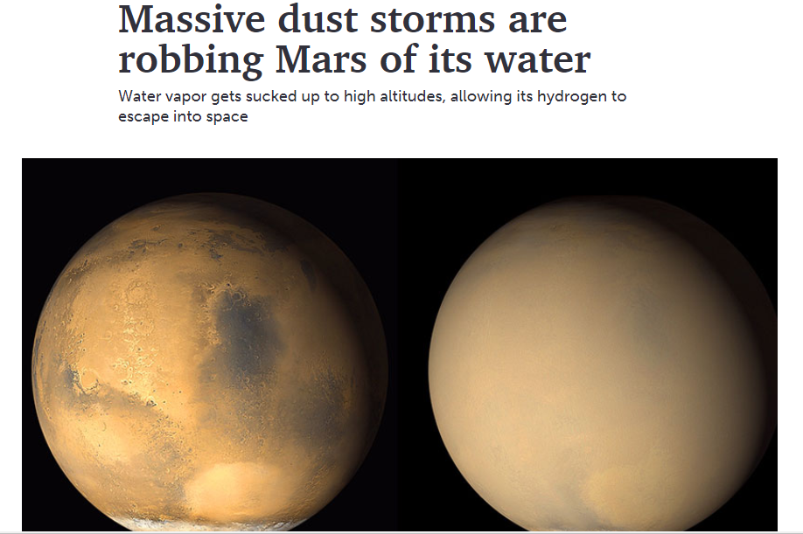
We will explore the parts of the water cycle
EXTENSION
https://www.sciencenews.org/article/mars-dust-storms-water It contains some more advanced concepts, such as the chemical decomposition of water into hydrogen and oxygen.

Slide 12
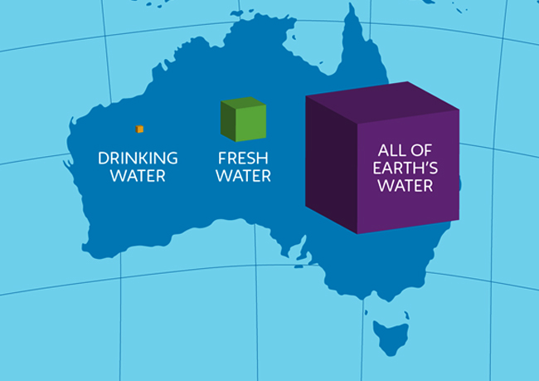
We will explore the parts of the water cycle
How is water distributed on Earth?
Notes:
1000ml
972ml (salt water)
28ml (fresh water)
23.5ml (ice caps and glaciers)
4ml (ground water)
0.5ml (lakes and rivers)
0.25ml (soil and air)

Slide 13
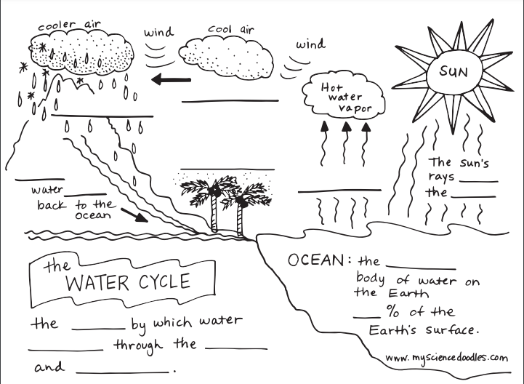

5 minutes
SWBAT investigate biochemical cycling
Copy and complete the water cycle in your books.
HINT
Use these words: Condensation Precipitation Run off Evaporation Transpiration Accumulation Bonus: Infiltration & Sublimation

Slide 14
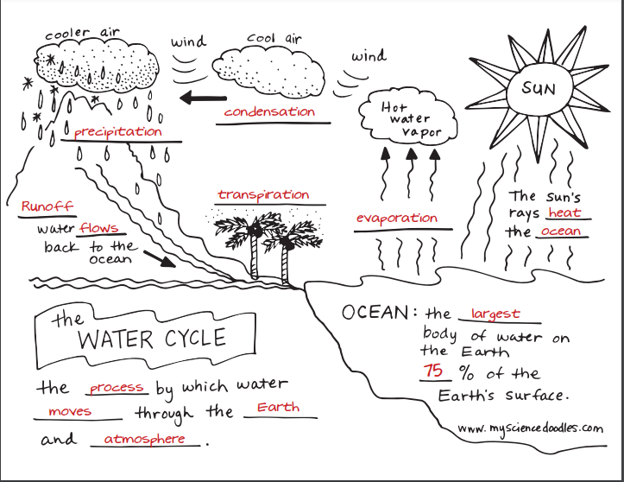
SWBAT investigate biochemical cycling
Infiltration:
the process by which water on the ground surface enters the soil.
Sublimation:
Snow and ice changing into water vapor in the air without first melting into water.

Slide 15
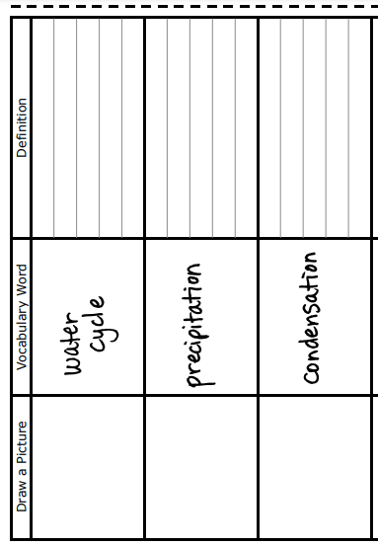
SWBAT investigate biochemical cycling
Draw the following table in your book and fill in the picture and definition
3 minutes

Slide 16
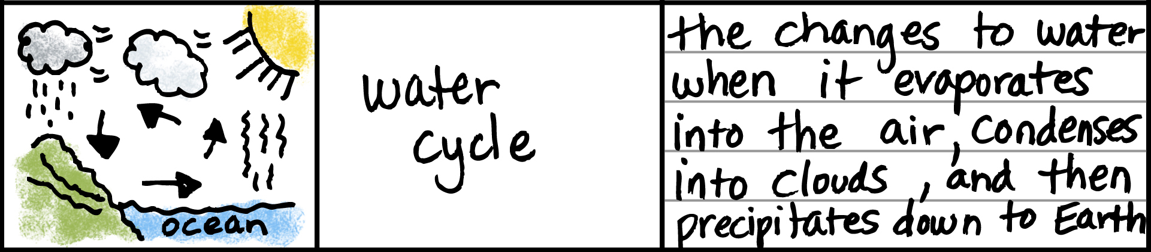
SWBAT investigate biochemical cycling

Slide 17
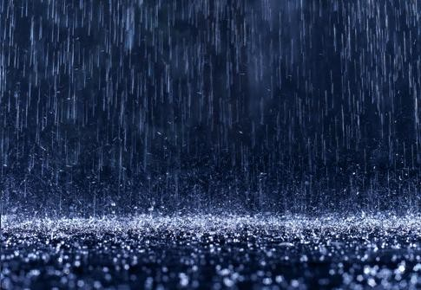
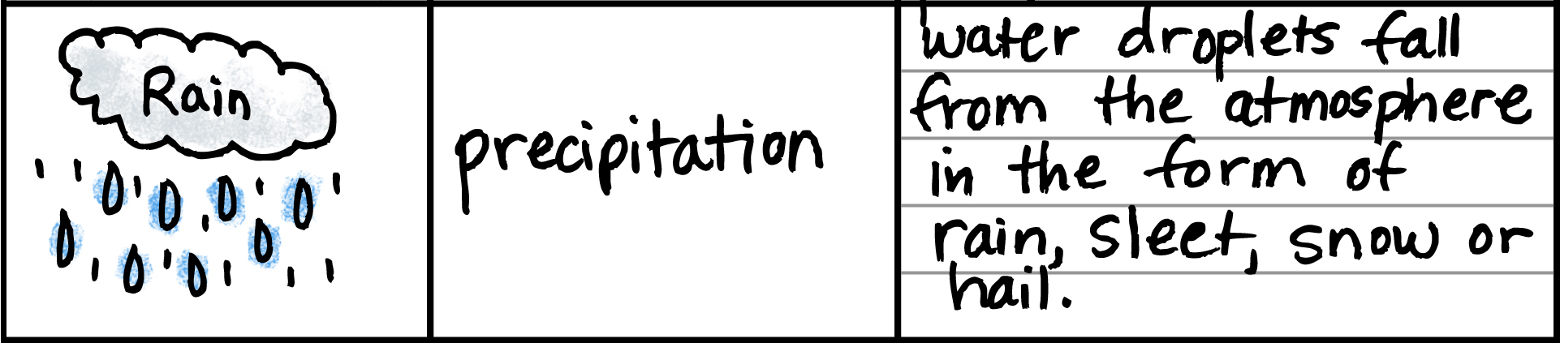
SWBAT investigate biochemical cycling

Slide 18
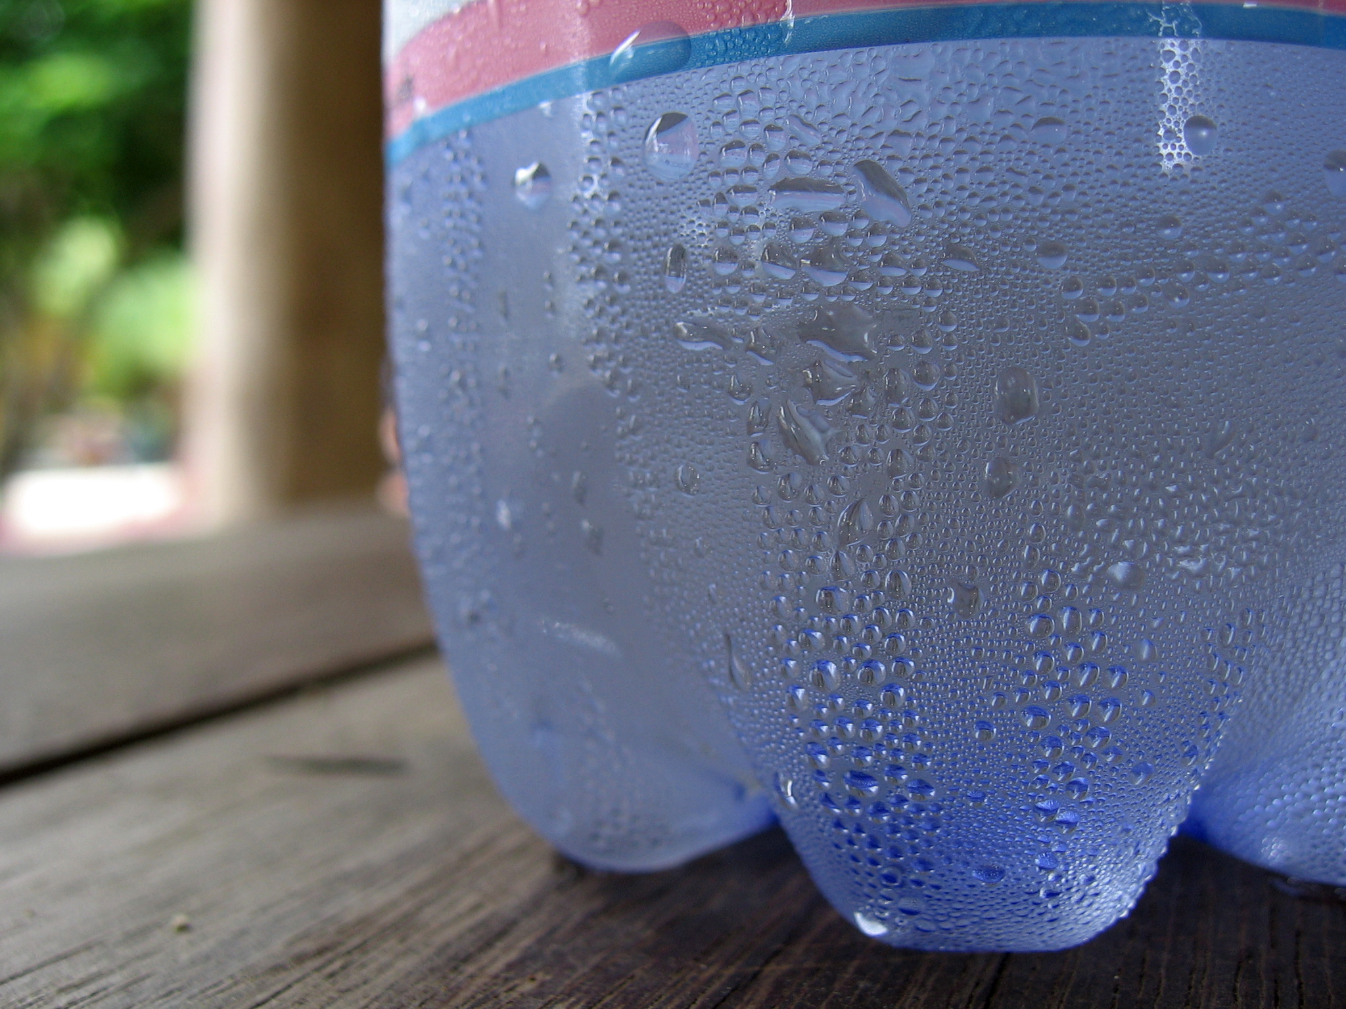
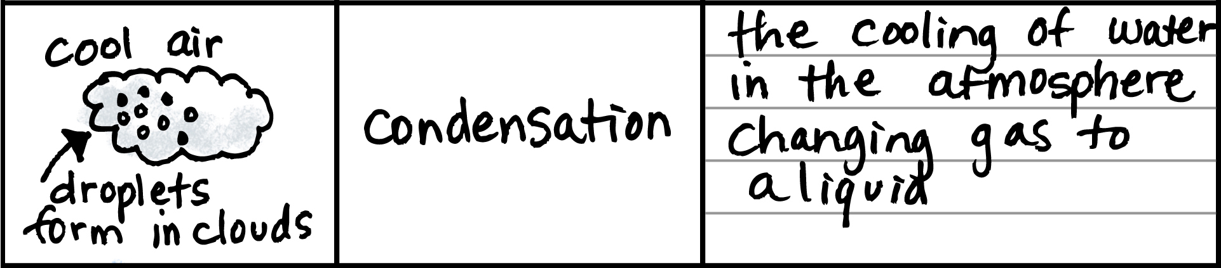
SWBAT investigate biochemical cycling

Slide 19
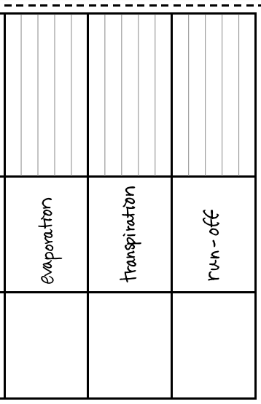
SWBAT investigate biochemical cycling
Draw the following table in your book and fill in the picture and definition
3 minutes

Slide 20
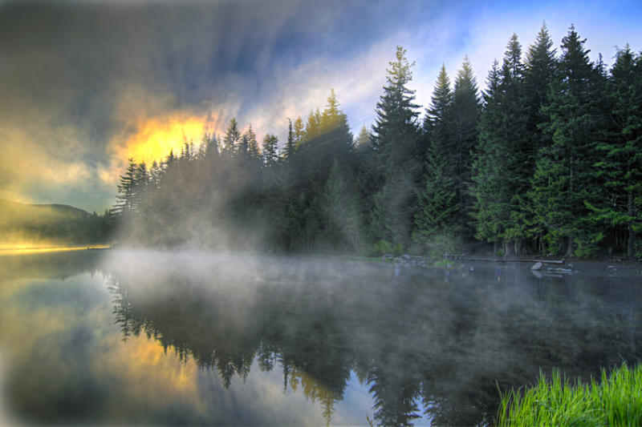
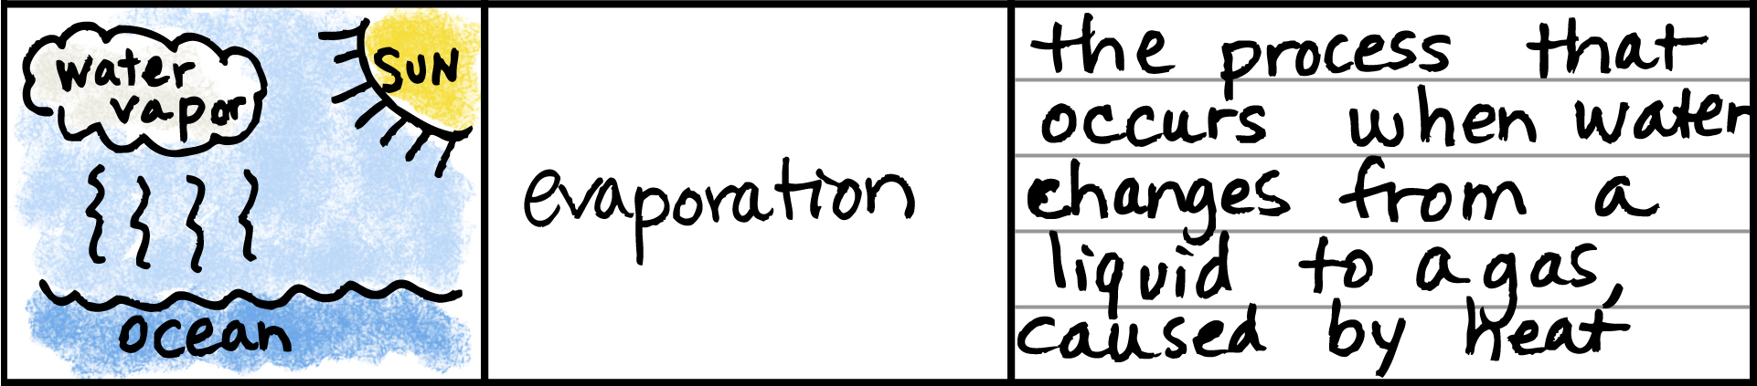
SWBAT investigate biochemical cycling

Slide 21
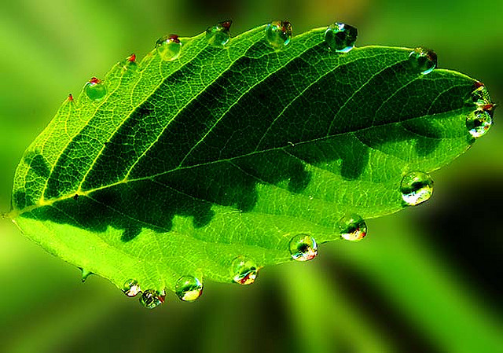
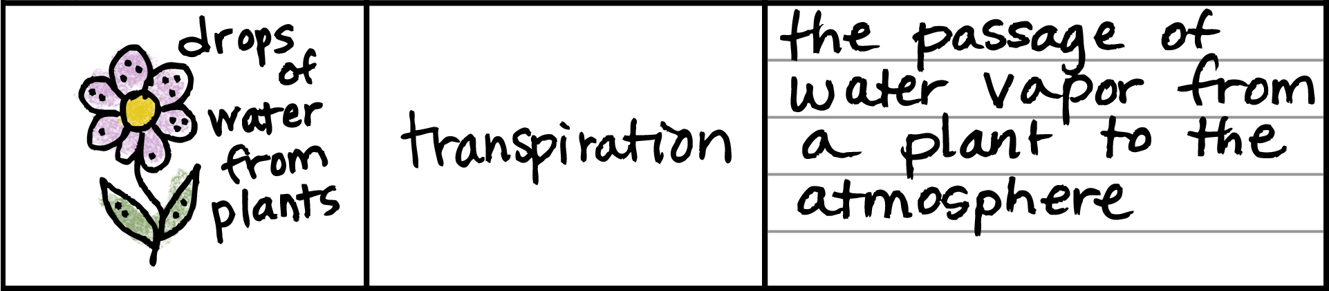
SWBAT investigate biochemical cycling

Slide 22
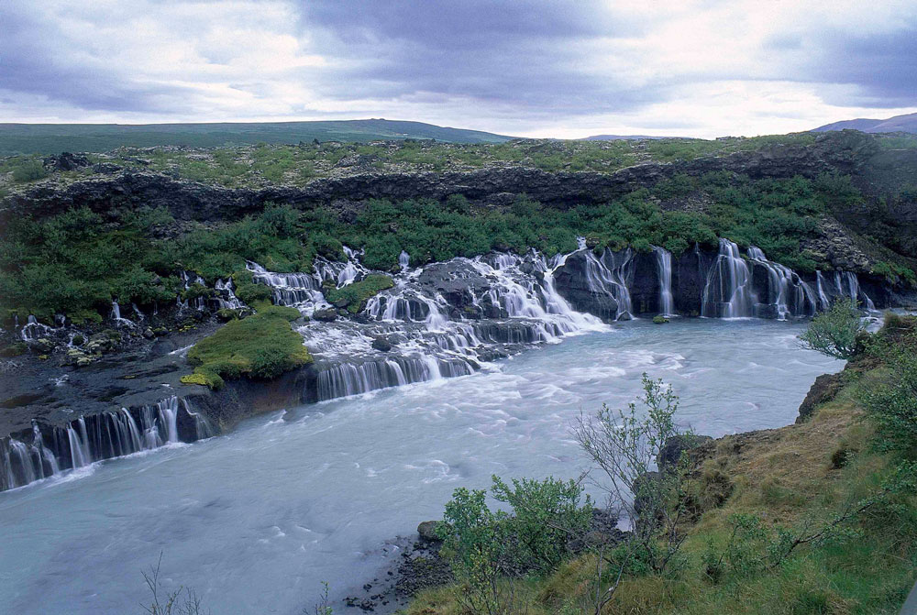
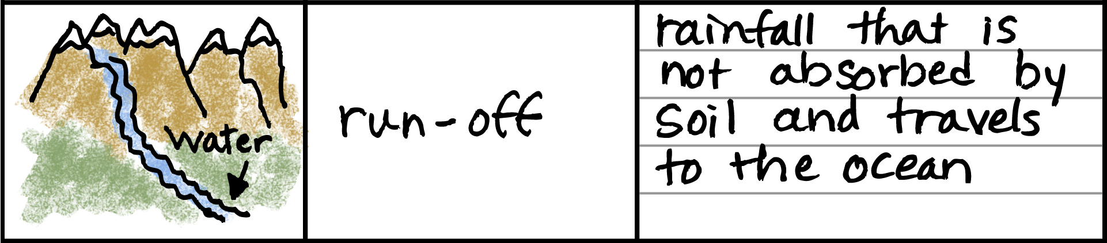
SWBAT investigate biochemical cycling

Slide 23
SWBAT investigate biochemical cycling
What is the process that occurs when water changes from a liquid to a gas, caused by heat?

Slide 24
SWBAT investigate biochemical cycling
What is the passage of water vapor from a plant to the atmosphere?

Slide 25
SWBAT investigate biochemical cycling
What are water droplets that fall from the atmosphere in the form of rain, sleet, snow, or hail?

Slide 26
SWBAT investigate biochemical cycling
What is rainfall that is not absorbed by soil and travels to the ocean?

Slide 27
SWBAT investigate biochemical cycling
What is the cooling of water in the atmosphere changing gas to a liquid?

Slide 28
SWBAT investigate biochemical cycling
What are the changes to water when it evaporates into the air, condenses into clouds, and then precipitates down to Earth?

Slide 29
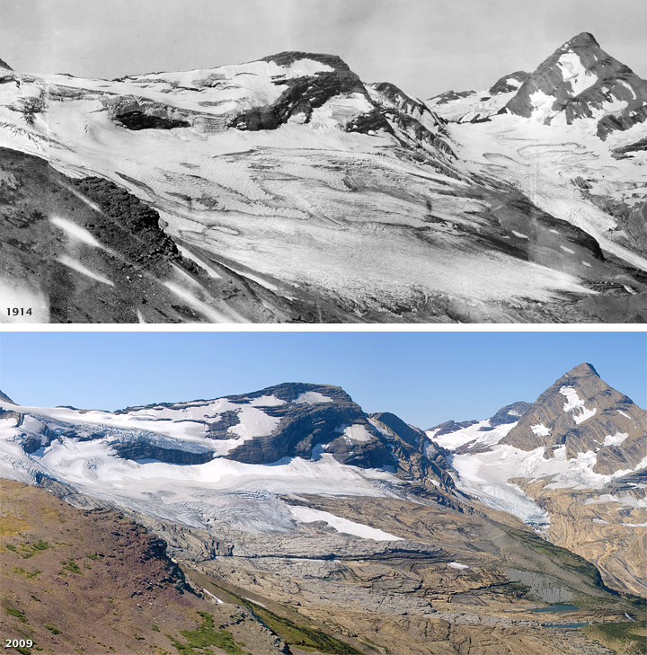
We will explore the parts of the water cycle
Changes in Ice Cover
MAKE THE CONNECTION
What does this image show you? Describe what the image is showing to your partner.
End
1
2
3
4
5
6
7
8
9
10
11
12
13
14
15
16
17
18
19
20
21
22
23
24
25
26
27
28
29
30

Slide 30
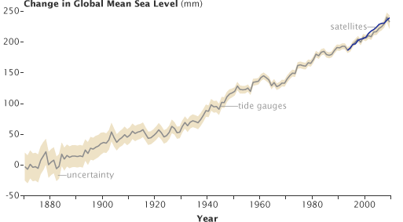
We will explore the parts of the water cycle
Sea Levels
End
1
2
3
4
5
6
7
8
9
10
11
12
13
14
15
16
17
18
19
20
21
22
23
24
25
26
27
28
29
30
MAKE THE CONNECTION
What does this image show you? Describe what the image is showing to your partner.
Sea level has been rising over the past century, partly due to thermal expansion of the ocean as it warms, and partly due to the melting of glaciers and ice caps

Slide 31
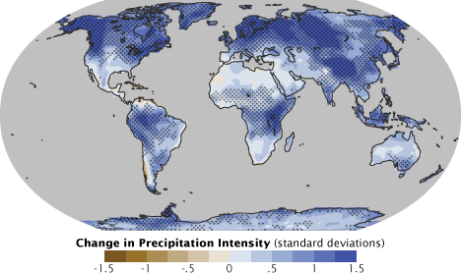
We will explore the parts of the water cycle
Predicted change in precipitation
End
1
2
3
4
5
6
7
8
9
10
11
12
13
14
15
16
17
18
19
20
21
22
23
24
25
26
27
28
29
30
MAKE THE CONNECTION
What does this image show you? Describe what the image is showing to your partner.

Slide 32
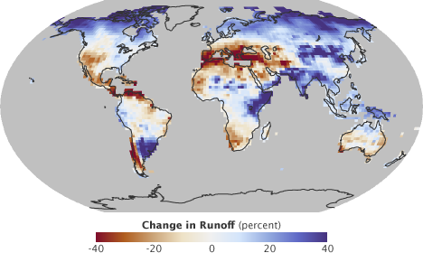
We will explore the parts of the water cycle
Predicted change in runoff
End
1
2
3
4
5
6
7
8
9
10
11
12
13
14
15
16
17
18
19
20
21
22
23
24
25
26
27
28
29
30
MAKE THE CONNECTION
What does this image show you? Describe what the image is showing to your partner.

Slide 33
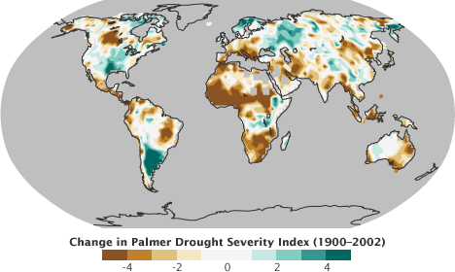
We will explore the parts of the water cycle
Predicted drought severity
End
1
2
3
4
5
6
7
8
9
10
11
12
13
14
15
16
17
18
19
20
21
22
23
24
25
26
27
28
29
30
MAKE THE CONNECTION
What does this image show you? Describe what the image is showing to your partner.

Slide 34
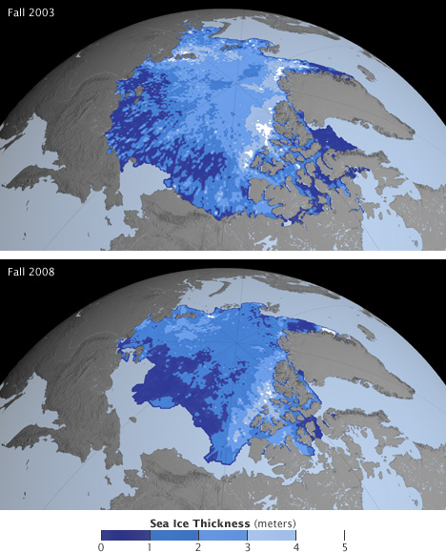
We will explore the parts of the water cycle
Changes in Sea Ice Thickness
MAKE THE CONNECTION
What does this image show you? Describe what the image is showing to your partner.
End
1
2
3
4
5
6
7
8
9
10
11
12
13
14
15
16
17
18
19
20
21
22
23
24
25
26
27
28
29
30

Slide 35
We will explore₁ the parts of the water cycle
TRACK WITH ME
READ WITH ME
We will identify the parts of the water cycle
We will describe the interactions between the parts of the cycle
We will explain the impact of humans on the water cycle
DECLARE THE OBJECTIVE
Read the learning objective to your partner.
VOCABULARY
1 - inquire into or discuss (a subject) in detail.
Notes:
Learning Objectives contain concepts (nouns, big ideas), skills (verbs, measurable behaviours) and sometimes context (restricting or targeting conditions).
●Example: Students will be able to describe the concept of density and apply it to floating and sinking.
●
Success criteria are specific measurable outcomes that if met mean that the student has met the learning objective.
Examples:
•Students will be able to compare densities of substances using mass and volume.
•Students will be able to identify whether a solid or liquid will float or sink in a liquid based on their densities.

